Slide 1

Transparent charity-based Crowdfunding platform using Blockchain and Smart Contract
Blockchain for Philanthropy
Anubhav Garg 201000007
Soham Banerjee 201010250
Supervisor:
Dr. Satyanarayana Vollala
Dr. Shyama Prasad Mukherjee
International Institute of Information Technology Naya Raipur

Slide 2

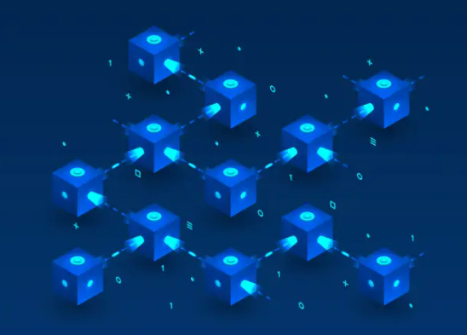
Introduction
Blockchain is a system of recording information in a way that makes it difficult or impossible to change, hack, or cheat the system.
A blockchain is essentially a digital ledger of transactions that is duplicated and distributed across the entire network of computer systems on the blockchain.

Slide 3
PROBLEM STATEMENT
Donors have every reason to fear that charitable funds will not reach people who really need them. According to the same HSE survey in 2017, 68% of citizens are willing to donate more if there is evidence of where and what they are going. By law, foundations are required to maintain public records .
Notes:
A fiber-optic cable, also known as an optical-fiber cable is a Guided Communication medium, is an assembly similar to an electrical broadband cable, but containing one or more optical fibers that are used to carry light or EM signals.
Core
The core carries the light. It is the smallest and most important part of the optical fiber. The core of the optical fiber is usually made of glass although some are of plastic. Used in the core, is a highly pure silicon dioxide (Si02), a very clear material. Refractive index is raised under controlled conditions through dopants such as Germania, phosphorous pentoxide, or alumina during manufacturing.
There’s no specific diameters for optical fiber cores as different sizes depend on the application. The range of usual glass cores is from as small as 3.7um up to 200um. For telecommunication, core sizes usually used is 9um, 50um and 62.5um. there is majorly two types of optical fiber which include the single-mode fiber and the multimode fiber based on the core sizes.
Single-mode fiber is one with 8 to 10 microns which lets light travels towards the center of the core in a single wavelength.
Multimode fiber is characterized with 50 or 62.5 microns.
On the other hand, optical fiber cores made of plastic are larger.
Cladding
The cladding covers the core. Its refractive index is lower to ensure the optical fiber works. The cladding and the core are manufactured together from the same silicon dioxide-based material in a permanently fused state whenever the glass cladding is used. A difference in refractive indexes of about 1% is maintained due to different amounts of dopants being added to the core and the cladding during the manufacturing process. Although the numbers are dependent upon the wavelength, the usual core is likely to have a refractive index of 1,49 at 1300nm while that of the cladding is 1.47.
The cladding is manufactured, using standard diameters. Two mostly used diameters are 125um and 140um. Core sizes such as 9um, 50um, and 62.5um, are typically supported by the 125um cladding while 140um cladding has 100um.
Coating
This is more like the protective layer of the optical fiber. It protects the cladding from damage by way of engrossing the shocks, nicks, scrapes, and even moisture that could damage the cladding. Without the coating, an optical fiber is very fragile. Glasss fibers are not sold without the coating because they are essential for protection. The diameter of the coating is usually of 250um or 500um. Naturally the coating is colourless; although some applications prefers to colour it easily.

Slide 4
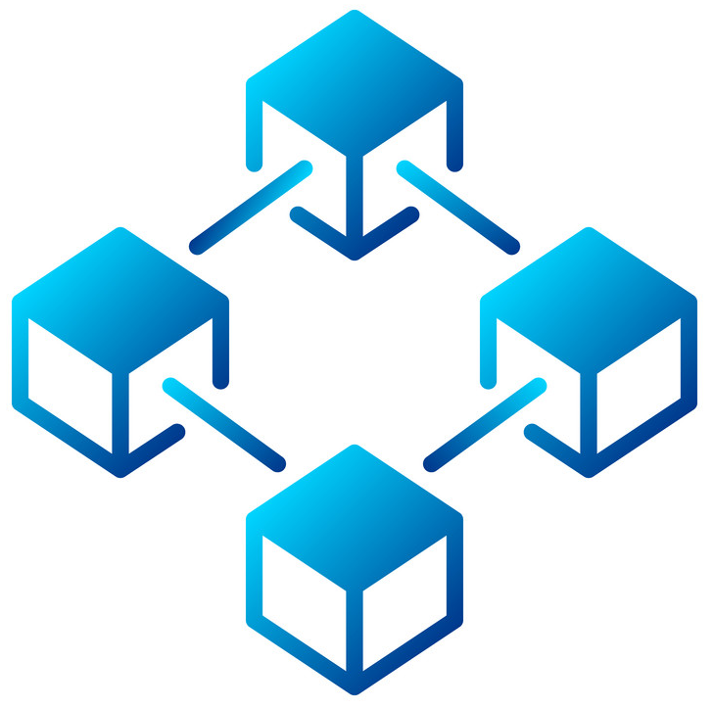
Technology used in our project
Blockchain
Smart Contract
Notes:
Whenever a ray of light travels from optically denser medium to optically rarer medium, Total Internal Reflection (TIR) takes place. In the given media like glass, water etc. the ray of light continues to get reflected.
As the ray is travelling from a medium of higher refractive index to a medium with a lower refractive index, the ray of light will move away from the normal.

Slide 5
Literature Review
S.No. | Charitable foundation / projects | Blockchain platform / cryptocurrency | Blockchain technology using
1. | GiveTrack | BTC | GiveTrack is a platform use to collect donations, and share updates with owners about how their contributions are used.
2. | GiveCrypto.org | BTC/BCH/ETH/ LTC/ZEC/XRP | The platform for raising funds for charitable purposes in different cryptocurrencies.
3. | Coin 4 Clothes | BCH | Offers earn BCH for donations in the form of clothing. The project provides education and support to each clothing donor by reaching them how to store their coins, how to send and receive transactions, and where they can spend them. The charity fund provides clothing to the needy.

Slide 6
DIFFERENT ROLES
There are four roles:
1) Donor:
Donors are the one who donates their goods to the beneficiary (fundraisers) or to the charity administrator.
2) Beneficiary (Fundraisers)
Beneficiary are the one who receive the fund from the donors but before they receive their funds they have to fill the all the required details and create their charity project and post it on the charity platform.
3) Cooperative shops
Beneficiaries make them to obtain tokens from the donors. They can exchange tokens for real money by charity organizations.
4) Charity Organization:
The organization can get donation from the platform to help other people and apply money to the cooperative shops for token exchanging.
Notes:
Now i am going to explain about a research which addressing this king of eavesdropper attack.

Slide 7

The proposed Solution
To build a crowd chain which will be a simple ethereum based charity raising and fundraising decentralized application where a user can create a new cause and a user can fund the cause. The cryptocurrency that the app use is Ether as medium of exchange.

Slide 8
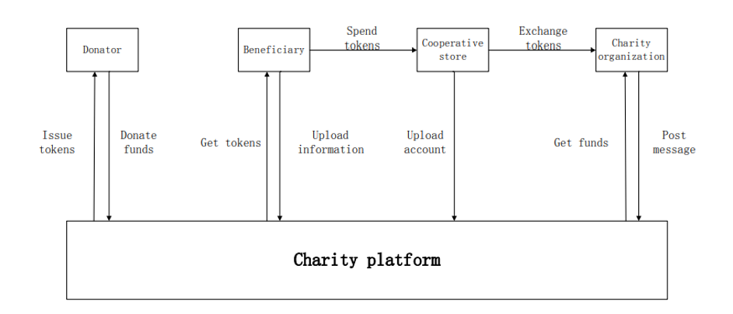
The proposed model

Slide 9
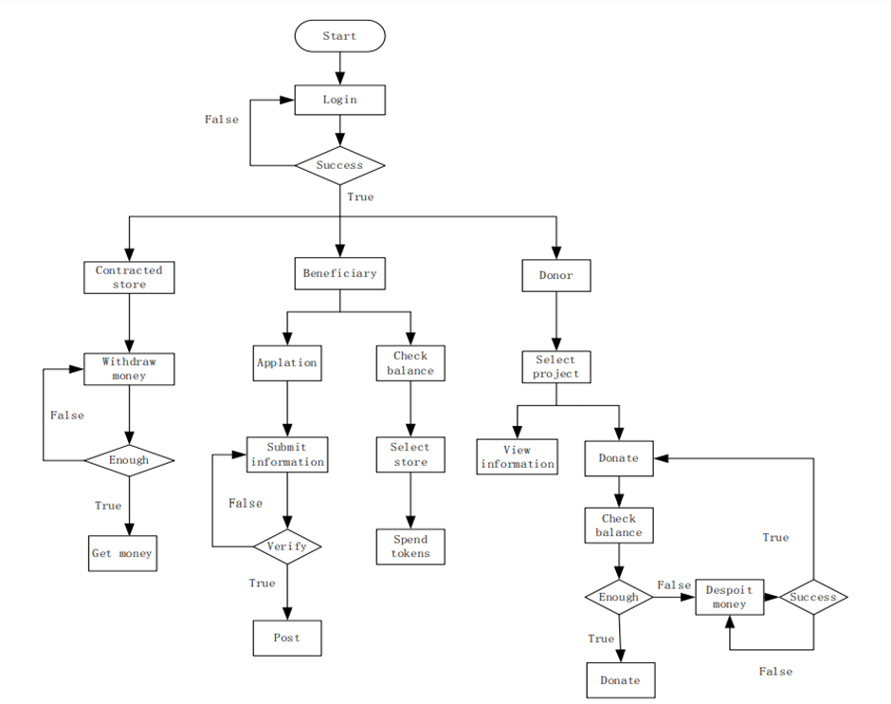
The proposed model

Slide 10
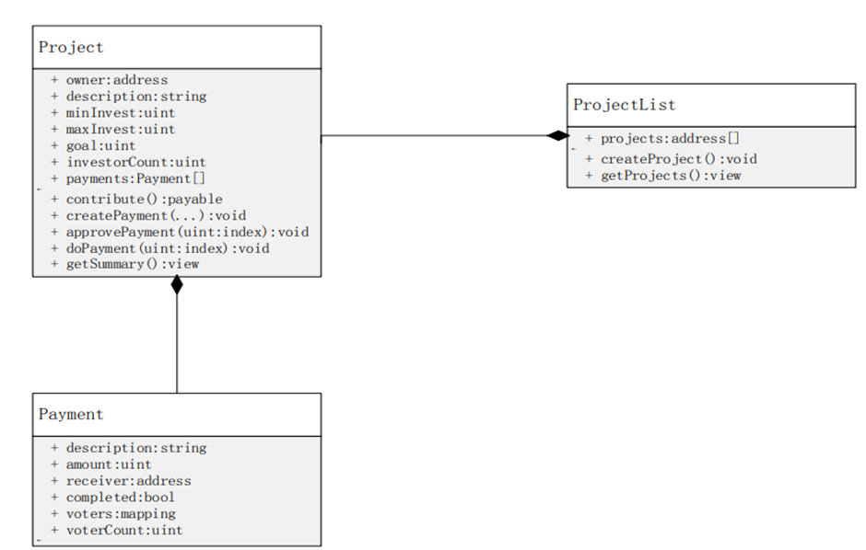
Dapp smart contract structure

Slide 11
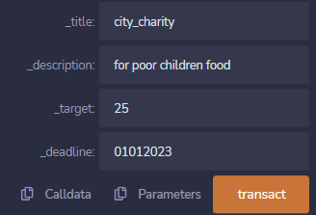
results
A new charity created

Slide 12
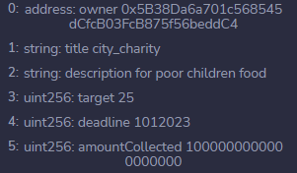
results
charity information

Slide 13
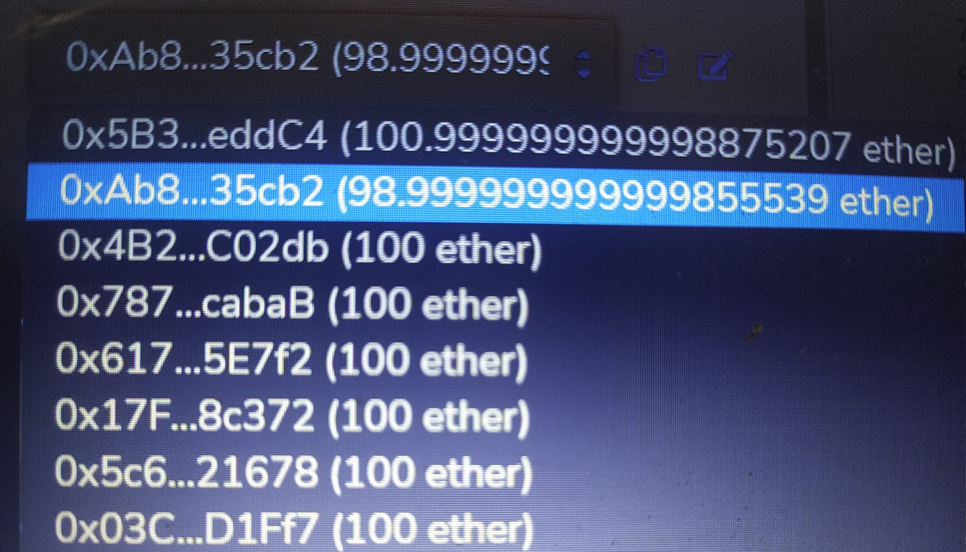
results
Addresses after donation

Slide 14
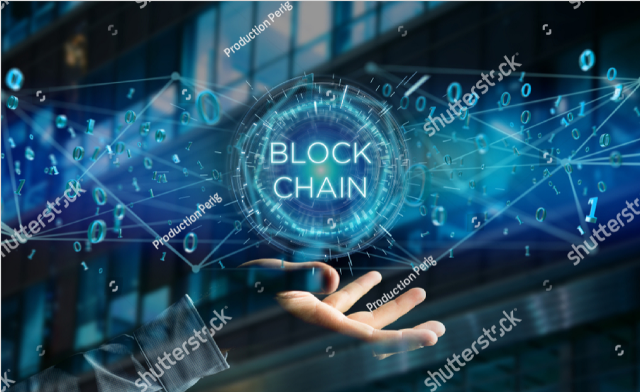
Future scope of research
Blockchain technology has a great future worldwide. An incredible scope of blockchain technology has been observed in the financial field. Blockchain technology helps charities become more transparent.
Functional Dapps and NFT marketplaces.

Slide 15
References
1. Satoshi, N. Bitcoin: A Peer-to-Peer Electronic Cash System. Available online: https://bitcoin.org/bitcoin.pdf (accessed on 11 April 2021).
2. Irshad, S.; Brohi, M.N.; Soomro, T.R. Block-ED: The Proposed Blockchain Solution for Effectively Utilising Educational Resources. Appl. Comput. Syst.2020, 25, 1–10. [Google Scholar] [CrossRef]
3. Bhatia, S.; Wright De Hernandez, A.D. Blockchain Is Already Here. What Does That Mean for Records Management and Archives? J. Arch. Organ. 2019, 16,75–84. [Google Scholar] [CrossRef]

Slide 16
Thank You
Dr. Shyama Prasad Mukherjee
International Institute of Information Technology Naya Raipur

